Slide 1





APP USER MANUAL
Symptora
BY : Lakshanya Jayakumar
Page 1
Next Slide

Slide 2
Table of Contents
1.ACKNOWLEDGEMENTS
2.ABOUT ME
3.INTERNSHIP JOURNEY
5.HOW TO USE THE APP
6.CONTACT PERSON
4.ABOUT APP
Page 3
Next Slide

Slide 3


APP USER MANUAL - SYMPTORA
ACKNOWLEDGMENTS
A small vote of thanks to all who have helped me in this journey of App Development –my parents, Mentors, Dr. Ken Kahn, Group Members, Friends, etc. I would like to give a big thank you to Miss Mani for making this journey amazing! Thank you Clevered team for this opportunity!
Page 3
Next Slide

Slide 4
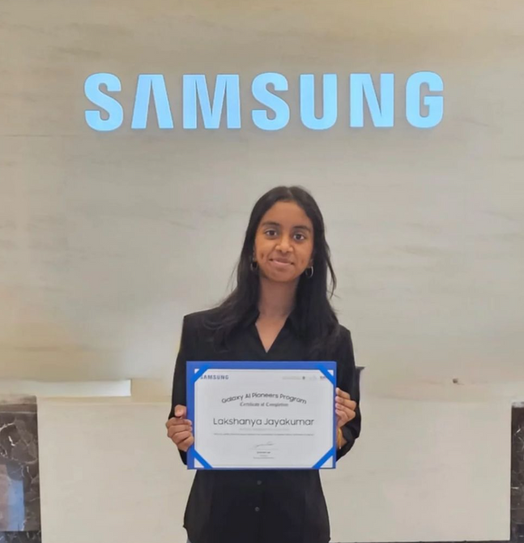
APP USER MANUAL - SYMPTORA
MY
INTRODUCTION
My Name is Lakshanya.
I am 12 years old
I live in Dubai , United Arab Emirates.
I am studying at Al Diyafah High School , Year 7
My aim is to become a software engineer or data scientist.
Page 4
Next Slide

Slide 5

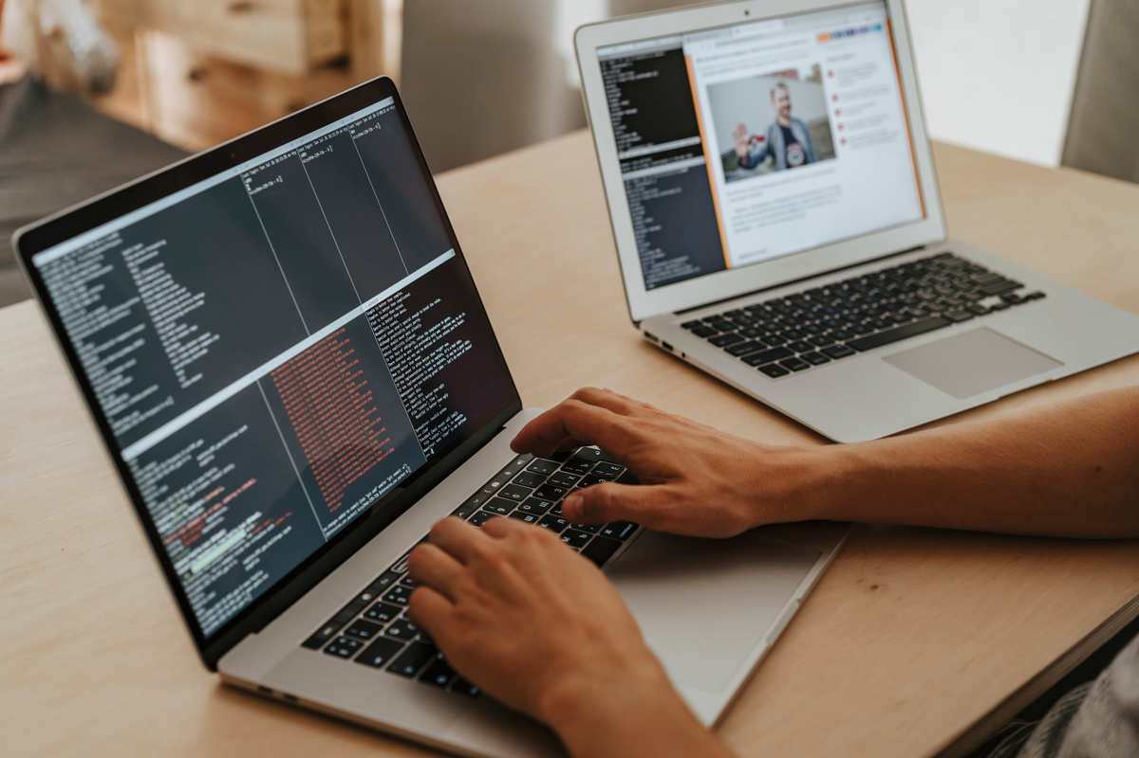
APP USER MANUAL - SYMPTORA
INTERNSHIP
JOURNEY
During my internship journey with Clevered, I gained valuable experience in developing a real-world application while enhancing my problem-solving and critical-thinking skills.
I learned how to design, refine, and present my ideas effectively, making this an enriching and insightful experience.
Page 5
Next Slide

Slide 6
APP USER MANUAL - SYMPTORA
Symptora is a health app that helps people identify possible diseases based on their symptoms. Users can select their symptoms from a list, and the app predicts the most likely disease.
This app is very helpful in the community as it spreads health awareness and encourages people to seek medical help early!
My App
Overview
Page 6
Next Slide

Slide 7
APP USER MANUAL - SYMPTORA
HOW TO
USE THE APP?
Page 5
Next Slide

Slide 8
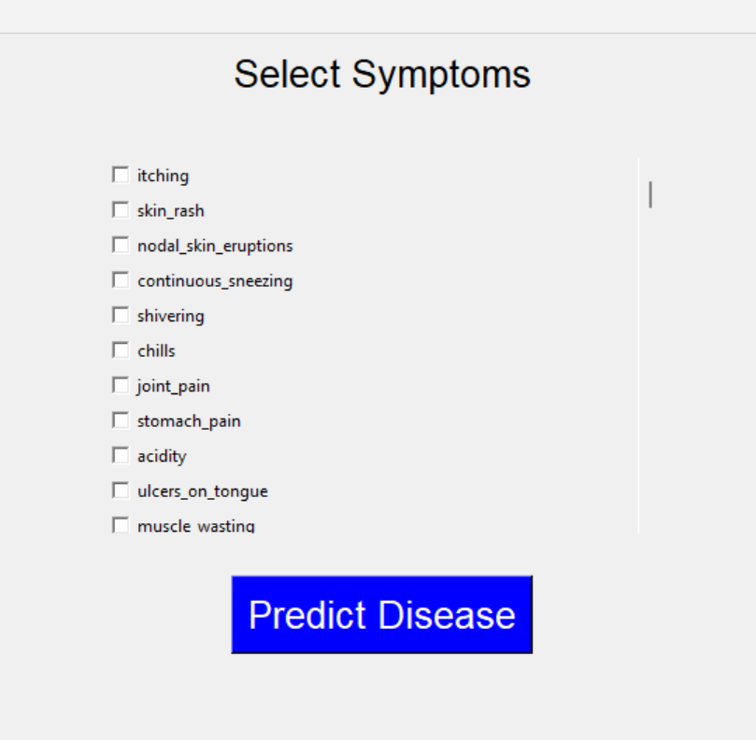
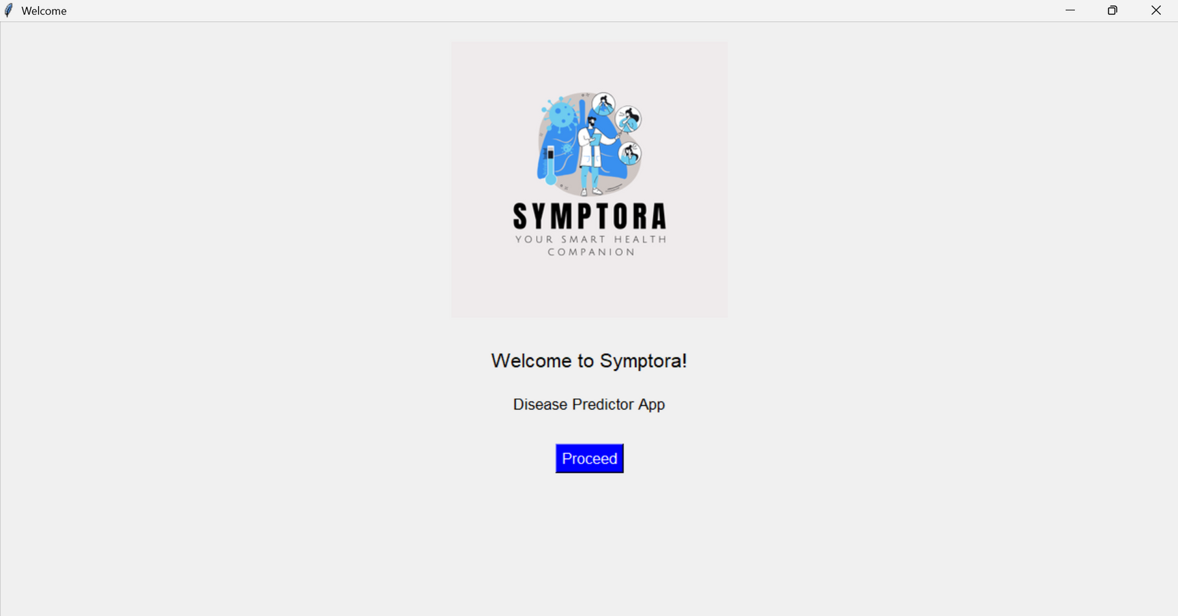
APP USER MANUAL - SYMPTORA
CHOOSE WHAT SYMPTOMS YOU HAVE
CLICK ON THIS BUTTON TO CHECK WHAT DISEASE YOU HAVE
CLICK ON THIS BUTTON TO GO TO THE NEXT PAGE
Page 8
Next Slide

Slide 9

APP USER MANUAL - SYMPTORA
TOOLKIT
WALKTHROUGH
Page 5
Next Slide

Slide 10

APP USER MANUAL - SYMPTORA
2025
Contact
Person
If any queries or doubts reach out to Lakshanya J at lakshu.jk2012@gmail.com for any questions or concerns/ suggestions on the App!
Page 9
Next Slide

Slide 11

APP USER MANUAL - SYMPTORA
Thank
You!
Page 10
Next Slide

